Slide 1
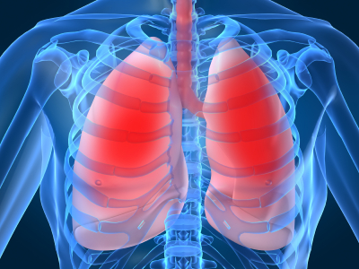
LECTURE NO (1)
Respiratory Physiology Bader Hassan
Lecturer Of Physiology
Introduction
Faculty Of Medicine Dept.Of Physiology

Slide 2
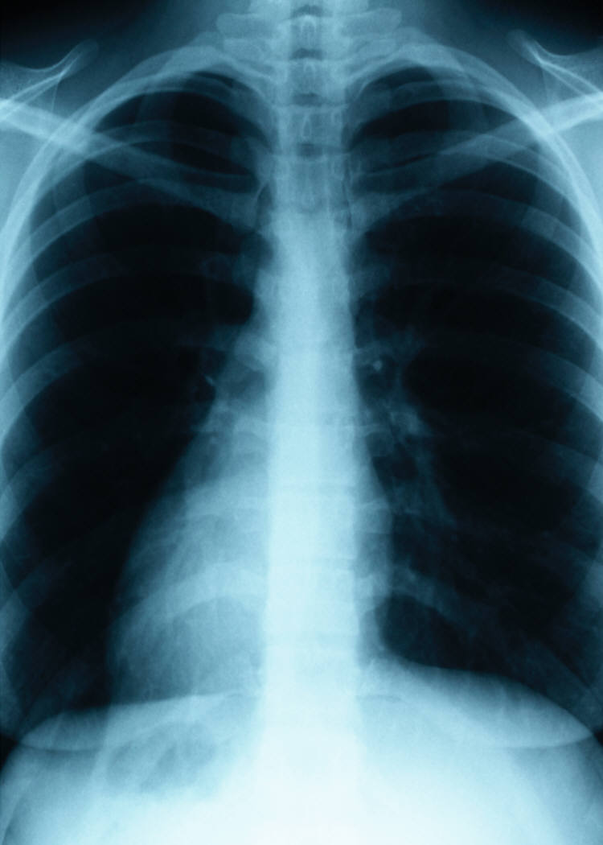

Slide 3
What is respiration?
External respiration - exchange of O2 & CO2 between respiratory surfaces & the blood [breathing].
Internal respiration - exchange of O2 & CO2 between the blood & cells.
Cellular respiration - process by which cells use O2 to produce ATP.
Notes:
Remember, oxygen is the final electron acceptor in cellular respiration (O₂ combines with H⁺ & electrons to form H₂O).

Slide 4
Structure & function
Divisions :
The respiratory system is divided anatomically into:
Upper respiratory tract:
Include structures outside the thoracic cavity
The nasal cavity, larynx & upper part of the trachea

Slide 6
Lower respiratory tract:
Include structure inside the thoracic cavity.
The lower part of the trachea, bronchi, bronchioles, alveolar ducts & alveoli.

Slide 7
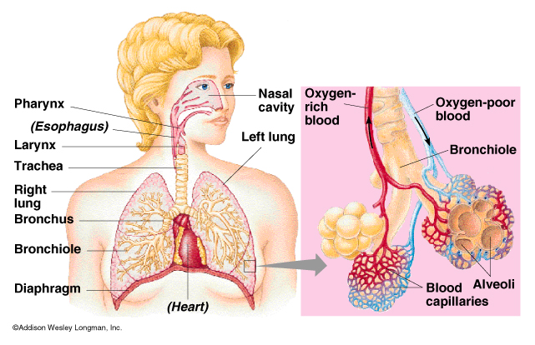

Slide 8
Respiratory system is divided physiologically into:
Conducting zone:
For conduction of air to the lower zone
Includes the nasal cavity, pharynx, larynx, trachea, bronchi & bronchioles.

Slide 9
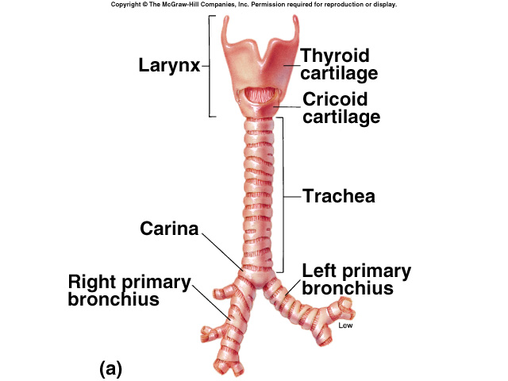
Conducting Zone

Slide 10
Respiratory zone:
For gas exchange. Includes the respiratory bronchioles, alveolar duct , alveolar sacs & alveoli.

Slide 12
Path of air flow in external respiration:
nose →
pharynx →
larynx →
trachea →
bronchi →
bronchioles →
alveoli

Slide 13
The pleural cavity
Each lung is covered by a membrane that is attached tightly to its outer surface (the visceral membrane).
The membrane continues to line the inner surface of the chest wall (parietal membrane).
The space which is found between the visceral & parietal membranes called pleural cavity.
pleural cavity contains a few millimeters of fluid that act as a lubricant.

Slide 14
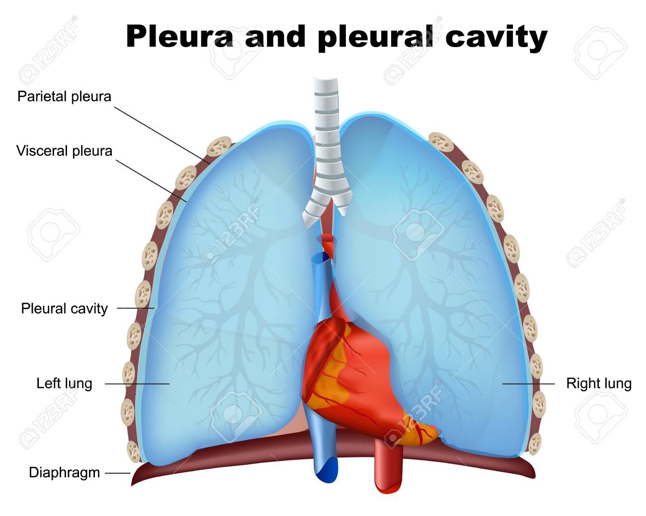

Slide 15
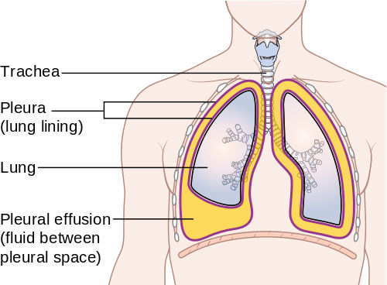

Slide 16
Functions of the respiratory system
Provides O2 to the tissues.
Eliminate CO2 from the tissues.
Regulates pH of the blood.
Other functions:
Participates in the regulation of body temperature (e.g. by hyperventilation to lose heat).

Slide 17
Protection by:
Hairs within the nose for filtration of air.
Mucous on the airways for trapping of smaller particles.
Cilia on cells for transporting the trapped particles upwards to be coughed out.
Cough & sneezing reflexes for ejecting unwanted substances through the mouth.
Antibodies within the respiratory secretion & alveolar macrophage for ingestion of bacteria & foreign particles.

Slide 18
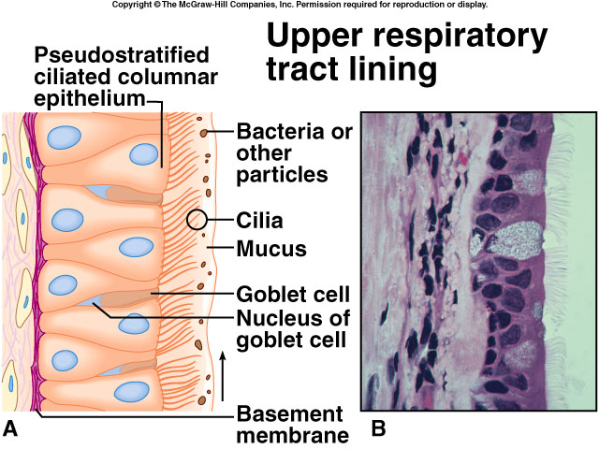
Notes:
Lining of nasal cavity (as well as entire upper respiratory tract) is composed of pseudostratified ciliated columnar epithelium.
This epithelium contains numerous mucus-producing goblet cells.
Mucus functions to moisten air & trap small particles. Cilia move mucus & embedded particles to pharynx to be swallowed.
Nose hairs filter large particles out of air.
Blood vessels beneath the epithelium release heat that warms incoming air.

Slide 20
(لا إله إلا أنت سبحانك إني كنت من الظالمين)

